Slide 1
NETWORK SCIENCE Lecture 2

Slide 2
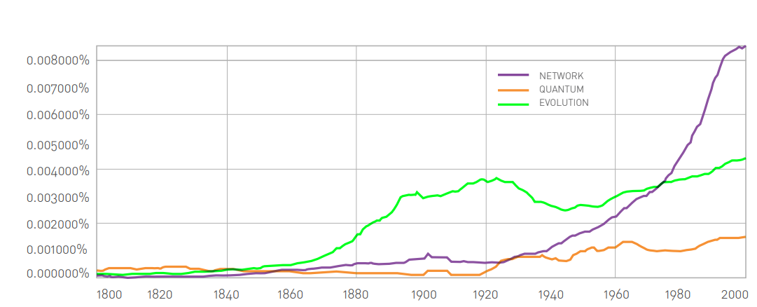
We learnt…
The frequency of use of the words evolution, quantum, and networks in books since 1880.
The plot indicates the exploding societal awareness of networks in the last decades of the 20th century, laying the ground for the emergence of network science.
The plots were generated by Google’s ngram platform, calculating the fraction of books published in a year
that mention evolution, quantum or networks.

Slide 3
Discussion
1.1. Networks Everywhere
List three different real networks and state the nodes and links for each of them.
1.2. Your Interest
Tell us of the network you are personally most interested in. Address the following questions:
(a) What are its nodes and links?
(b) How large is it?
(c) Can be mapped out?
(d) Why do you care about it?
1.3 Impact
In your view what would be the area where network science could have the biggest impact in the next decade? Explain your answer

Slide 4
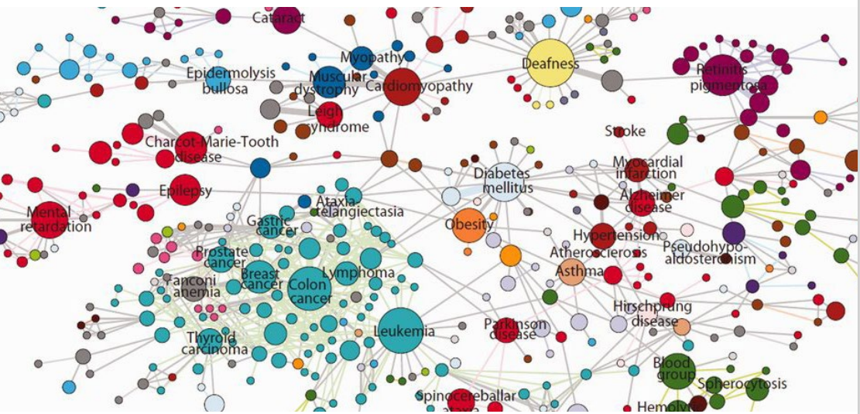
Human Disease Network
The Human Disease Network, whose nodes are diseases connected if they have common genetic origin. Published as a supplement of the Proceedings of the National Academy of Sciences, the map was created to illustrate the genetic interconnectedness of apparently distinct diseases.
With time it crossed disciplinary boundaries, taking up a life of its own. The New York Times created an interactive version of the map and the London-based Serpentine Gallery, one of the top contemporary art galleries in the world, have exhibited it part of their focus on networks and maps. It is also featured in numerous books on design and maps.

Slide 5
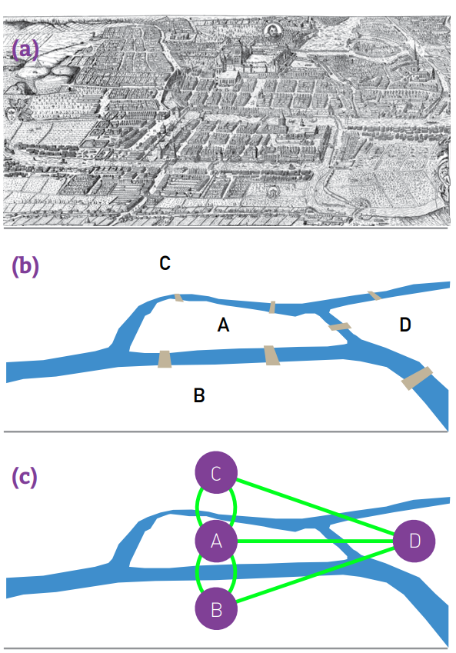
The Bridges of Königsberg
Few research fields can trace their birth to a single moment and place in history. Graph theory, the mathematical scaffold behind network science, can. Its roots go back to 1735 in Königsberg, the capital of Eastern Prussia, a thriving merchant city of its time. The trade supported by its busy fleet of ships allowed city officials to build seven bridges across the river Pregel that surrounded the town. Five of these connected to the mainland the elegant island Kneiphof, caught between the two branches of the Pregel. The remaining two crossed the two branches of the river (Figure). This peculiar arrangement gave birth to a contemporary puzzle: Can one walk across all seven bridges and never cross the same one twice? Despite many attempts, no one could find such path. The problem remained unsolved until 1735, when Leonard Euler, a Swiss born mathematician, offered a rigorous mathematical proof that such path does not exist.
Figure The Bridges of Königsberg

Slide 6
The Bridges of Königsberg
Euler represented each of the four land areas separated by the river with letters A, B, C, and D (Figure). Next he connected with lines each piece of land that had a bridge between them. He thus built a graph, whose nodes were pieces of land and links were the bridges. Then Euler made a simple observation: if there is a path crossing all bridges, but never the same bridge twice, then nodes with odd number of links must be either the starting or the end point of this path. Indeed, if you arrive to a node with an odd number of links, you may find yourself having no unused link for you to leave it. A walking path that goes through all bridges can have only one starting and one end point. Thus such a path cannot exist on a graph that has more than two nodes with an odd number of links. The Königsberg graph had four nodes with an odd number of links, A, B, C, and D, so no path could satisfy the problem.
Figure The Bridges of Königsberg

Slide 7
The Bridges of Königsberg
A contemporary map of Königsberg (now Kaliningrad, Russia) during Euler’s time.
A schematic illustration of Königsberg’s four land pieces and the seven bridges across them.
(c) Euler constructed a graph that has four nodes (A, B, C, D), each corresponding to a patch of land, and seven links, each corresponding to a bridge. He then showed that there is no continuous path that would cross the seven bridges while never crossing the same bridge twice. The people of Königsberg gave up their fruitless search and in 1875 built a new bridge between B and C, increasing the number of links of these two nodes to four. Now only one node was left with an odd number of links. Consequently we should be able to find the desired path. Homework: Can you find one yourself?
Figure The Bridges of Königsberg

Slide 8
The Bridges of Königsberg
Euler’s proof was the first time someone solved a mathematical problem using a graph. For us the proof has two important messages: The first is that some problems become simpler and more tractable if they are represented as a graph. The second is that the existence of the path does not depend on our ingenuity to find it. Rather, it is a property of the graph.
Indeed, given the structure of the Königsberg graph, no matter how smart we are, we will never find the desired path. In other words, networks have properties encoded in their structure that limit or enhance their behavior.
To understand the many ways networks can affect the properties of a system, we need to become familiar with graph theory, a branch of mathematics that grew out of Euler’s proof. We learn how to represent a network as a graph and introduce the elementary characteristics of networks, from degrees to degree distributions, from paths to distances and learn to distinguish weighted, directed and bipartite networks. We will introduce a graph-theoretic formalism and language.
Figure The Bridges of Königsberg

Slide 9
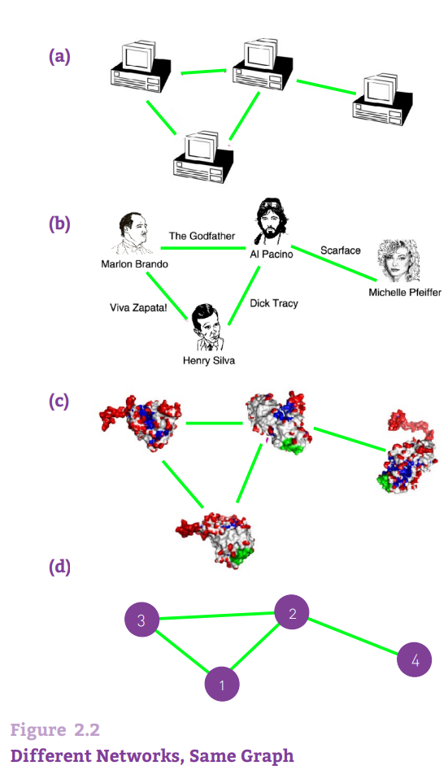
NETWORKS AND GRAPHS
If we want to understand a complex system, we first need to know how its components interact with each other. In other words we need a map of its wiring diagram.
A network is a catalog of a system’s components often called nodes or vertices and the direct interactions between them, called links or edges. This network representation offers a common language to study systems that may differ greatly in nature, appearance, or scope. Indeed, as shown in Figure 2.2, three rather different systems have exactly the same network representation.

Slide 10
Basic network parameters
Number of nodes, or N, represents the number of components in the system. We will often call N the size of the network. To distinguish the nodes, we label them with i = 1, 2, ..., N.
Number of links, which we denote with L, represents the total number of interactions between the nodes. Links are rarely labeled, as they can be identified through the nodes they connect. For example, the (2, 4) link connects nodes 2 and 4.
The networks shown in Figure 2.2 have N = 4 and L = 4.

Slide 11
Directed or undirected links of a network
The links of a network can be directed or undirected. Some systems have directed links, like the WWW, whose uniform resource locators (URL) point from one web document to the other, or phone calls, where one person calls the other. Other systems have undirected links, like romantic ties: if John dates Janet, Janet also dates John, or like transmission lines on the power grid, on which the electric current can flow in both directions. A network is called directed (or digraph) if all of its links are directed; it is called undirected if all of its links are undirected. Some networks simultaneously have directed and undirected links. For example, in the metabolic network some reactions are reversible (i.e., bidirectional or undirected) and others are irreversible, taking place in only one direction (directed).

Slide 12
System representation by Network
The choices we make when we represent a system as a network will determine our ability to use network science successfully to solve a particular problem. For example, the way we define the links between two individuals dictates the nature of the questions we can explore:
(a) By connecting individuals that regularly interact with each other in the context of their work, we obtain the organizational or professional network, that plays a key role in the success of a company or an institution, and is of major interest to organizational research.
(b) By linking friends to each other, we obtain the friendship network, that plays an important role in the spread of ideas, products and habits and is of major interest to sociology, marketing and health sciences.

Slide 13
System representation by Network (2)
(c) By connecting individuals that have an intimate relationship, we obtain the sexual network, of key importance for the spread of sexually transmitted diseases, like AIDS, and of major interest for epidemiology.
(d) By using phone and email records to connect individuals that call or email each other, we obtain the acquaintance network, capturing a mixture of professional, friendship or intimate links, of importance to communications and marketing.
While many links in these four networks overlap (some coworkers may be friends or may have an intimate relationship), these networks have different uses and purposes.

Slide 14
We can also build networks that may be valid from a graph theoretic perspective, but may have little practical utility. For example, if we link all individuals with the same first name, Johns with Johns and Marys with Marys, we do obtain a well-defined graph, whose properties can be analyzed with the tools of network science. Its utility is questionable, however.
Hence in order to apply network theory to a system, careful considerations must precede our choice of nodes and links, ensuring their significance to the problem we wish to explore.
Throughout our investigations we will use ten networks to illustrate the tools of network science. These reference networks span social systems (mobile call graph or email network), collaboration and affiliation networks (science collaboration network, Hollywood actor network), information systems (WWW), technological and infrastructural systems (Internet and power grid), biological systems (protein interaction and metabolic network), and reference networks (citations). They differ widely in their sizes, from as few as N =1,039 nodes in the E. coli metabolism, to almost half million nodes in the citation network.

Slide 15
They cover several areas where networks are actively applied, representing ‘canonical’ datasets frequently used by researchers to illustrate key network properties. As we indicate, some of them are directed, others are undirected.
We are discussing in detail the nature and the characteristics of each of these datasets, turning them into the guinea pigs of our journey to understand complex networks.

Slide 16
DEGREE, AVERAGE DEGREE, AND DEGREE DISTRIBUTION
If we want to understand a complex system, we first need to know how its components interact with each other. In other words we need a map of its wiring diagram.
A network is a catalog of a system’s components often called nodes or vertices and the direct interactions between them, called links or edges.
This network representation offers a common language to study systems that may differ greatly in nature, appearance, or scope. Indeed, as shown in Figure 2.2, three rather different systems have exactly the same network representation.

Slide 17

A key property of each node is its degree, representing the number of links it has to other nodes. The degree can represent the number of mobile phone contacts an individual has in the call graph (i.e. the number of different individuals the person has talked to), or the number of citations a research paper gets in the citation network.
DEGREE
We denote with ki the degree of the i_{th} node in the network. For example, for the undirected networks shown in Figure 2.2 we have k₁=2, k₂=3, k₃=2, k₄=1.
In an undirected network the total number of links, L, can be expressed as the sum of the node degrees:
￼ .
Here the 1/2 factor corrects for the fact that in the sum each link is counted twice. For example, the link connecting the nodes 2 and 4 in Figure 2.2 will be counted once in the degree of node 1 and once in the degree of node 4.

Slide 18

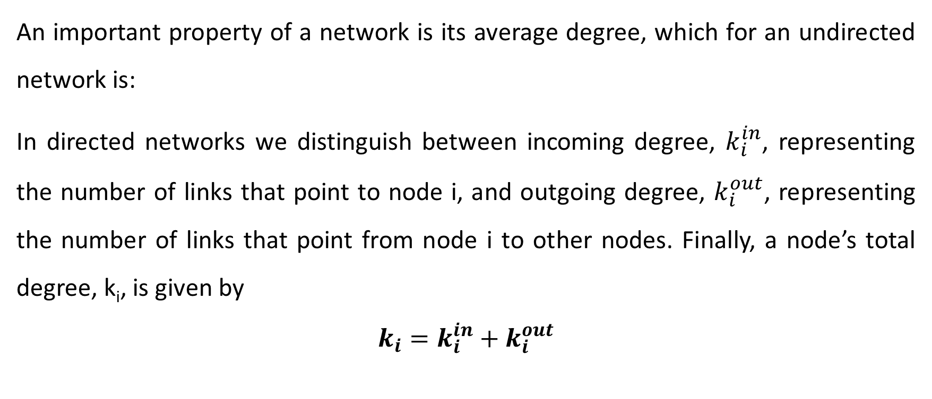
AVERAGE DEGREE
An important property of a network is its average degree, which for an undirected network is:
In directed networks we distinguish between incoming degree, $k_{i}^{in}$, representing the number of links that point to node i, and outgoing degree, $k_{i}^{out}$, representing the number of links that point from node i to other nodes. Finally, a node’s total degree, k_{i}, is given by
$$k_{i}=k_{i}^{in}+k_{i}^{out}$$

Slide 19


For example, on the WWW the number of pages a given document points to represents its outgoing degree, k_{out}, and the number of documents that point to it represents its incoming degree, k_{in}. The total number of links in a directed network is￼
The 1/2 factor seen earlier is now absent, as for directed networks the two sums separately count the outgoing and the incoming degrees. The average degree of a directed network is￼

Slide 20


DEGREE DISTRIBUTION
The degree distribution, p_{k}, provides the probability that a randomly selected node in the network has degree k. Since p_{k} is a probability, it must be normalized, i.e.
For a network with N nodes the degree distribution is the normalized
histogram is given by
where N_{k} is the number of degree-k nodes. Hence the number of degree-k nodes can be obtained from the degree distribution as
N_{k} = Np_{k}.

Slide 21

Degree distribution (2)
The degree distribution has assumed a central role in network theory following the discovery of scale-free networks. One reason is that the calculation of most network properties requires us to know p_{k}. For example, the average degree of a network can be written as
The other reason is that the precise functional form of pk determines many network phenomena, from network robustness to the spread of viruses.

Slide 22
ADJACENCY MATRIX
A complete description of a network requires us to keep track of its links. The simplest way to achieve this is to provide a complete list of the links.
For example, the network of Figure 2.2 is uniquely described by listing
its four links: {(1, 2), (1, 3), (2, 3), (2, 4)}. For mathematical purposes we often represent a network through its adjacency matrix. The adjacency matrix of a directed network of N nodes has N rows and N columns, its elements being:
A_{ij} = 1 if there is a link pointing from node j to node i
A_{ij} = 0 if nodes i and j are not connected to each other

Slide 23
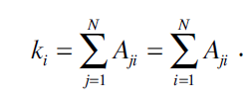
ADJACENCY MATRIX
The adjacency matrix of an undirected network has two entries for each link, e.g. link (1, 2) is represented as A₁₂ = 1 and A₂₁ = 1. Hence, the adjacency matrix of an undirected network is symmetric, A_{ij} = A_{ji}. The degree ki of node i can be directly obtained from the elements of the adjacency matrix. For undirected networks a node’s degree is a sum over either the rows or the columns of the matrix, i.e.

Slide 24


ADJACENCY MATRIX
For directed networks the sums over the adjacency matrix’ rows and columns provide the incoming and outgoing degrees, respectively
Given that in an undirected network the number of outgoing links equals the number of incoming links, we have
The number of nonzero elements of the adjacency matrix is 2L, or twice the number of links. Indeed, an undirected link connecting nodes i and j appears in two entries: A_{ij} = 1, a link pointing from node j to node i, and A_{ji} = 1, a link pointing from i to j.

Slide 25
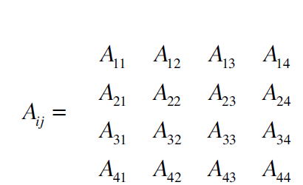
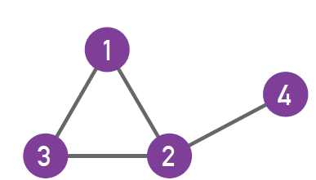
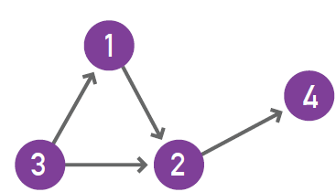
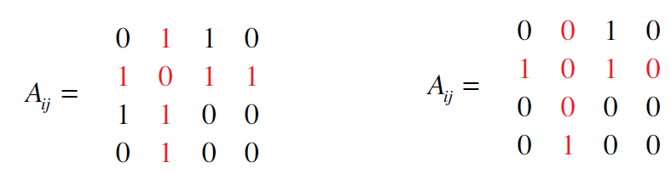
ADJACENCY MATRIX
Undirected network
Directed network

Slide 26
REAL NETWORKS ARE SPARSE
In real networks the number of nodes (N) and links (L) can vary widely.
For example, the neural network of the worm C. elegans, the only fully mapped nervous system of a living organism, has N = 302 neurons (nodes).
In contrast the human brain is estimated to have about a hundred billion N ≈ 1011) neurons. The genetic network of a human cell has about 20,000 genes as nodes; the social network consists of eight billion individuals (N ≈ 8×10⁹) and the WWW is estimated to have over many trillions web documents (N > 1012).

Slide 27

Number of Links
These wide differences in size are noticeable, which are reflected by N and L for several network maps. Some of these maps offer a complete wiring diagram of the system they describe (like the actor network or the E. coli metabolism), while others are only samples, representing a subset of the full network (like the WWW or the mobile call graph).
The number of links also varies widely. In a network of N nodes the number of links can change between L = 0 and Lmax, where
is the total number of links present in a complete graph of size N In a complete graph each node is connected to every other node.

Slide 28
L in real networks
In real networks L is much smaller than L_{max}, reflecting the fact that most real networks are sparse.
We call a network sparse if L<< L_{max}.
For example, the WWW graph in has about 1.5 million links.
Yet, if the WWW were to be a complete graph, it should have Lmax ≈ 5x1010 links
Consequently the web graph has only a 3x10⁻⁵ fraction of the links it could have.

Slide 29

WEIGHTED NETWORKS
So far we discussed only networks for which all links have the same weight, i.e. A_{ij} = 1. In many applications we need to study weighted networks, where each link (i, j) has a unique weight w_{ij}.
In mobile call networks
the weight can represent the total number of minutes two individuals talk with each other on the phone;
on the power grid the weight is the amount of current flowing through a transmission line.
For weighted networks the elements of the adjacency matrix carry the weight of the link as
Most networks of scientific interest are weighted, but we can not always measure the appropriate weights. Consequently we often approximate these networks with an unweighted graph. We predominantly focus on unweighted networks, but whenever appropriate, we discuss how the weights alter the corresponding network property.

Slide 30
BIPARTITE NETWORKS
A bipartite graph (or bigraph) is a network whose nodes can be divided into two disjoint sets U and V such that each link connects a U-node to a V-node. In other words, if we color the U-nodes green and the V-nodes purple, then each link must connect nodes of different colors
We can generate two projections for each bipartite network.
The first projection connects two U-nodes by a link if they are linked to the same V-node in the bipartite representation.
The second projection connects the V-nodes by a link if they connect to the same U-node

Slide 31
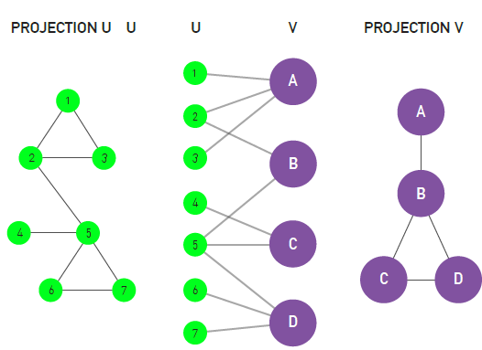
BIPARTITE NETWORKS
In network theory we encounter numerous bipartite networks. A well-known example is the Hollywood actor network, in which one set of nodes corresponds to movies (U), and the other to actors (V).
A movie is connected to an actor if the actor plays in that movie. One projection of this bipartite network is the actor network, in which two nodes are connected to each other if they played in the same movie.
The other connected if they share at least one projection is the movie network, in which two movies are actor in their cast.

Slide 32
PATHS AND DISTANCES
Physical distance plays a key role in determining the interactions between the components of physical systems. For example, the distance between two atoms in a crystal or between two galaxies in the universe determine the forces that act between them.
In networks distance is a challenging concept. Indeed, what is the distance between two webpages, or between two individuals who do not know each other?
The physical distance is not relevant here: Two webpages could be sitting on computers on the opposite sides of the globe, yet, have a link to each other.
At the same time two individuals that live in the same building may not know each other.

Slide 33
PATHS AND DISTANCES
In networks physical distance is replaced by path length.
A path is a route that runs along the links of the network.
A path’s length represents
the number of links the path contains.
Note that some texts require that each node a path visits is distinct.
In network science paths play a central role.

Slide 34
SHORTEST PATH
The shortest path between nodes i and j is the path with the fewest number of links The shortest path is often called the distance between nodes i and j, and is denoted by d_{ij}, or simply d. We can have multiple shortest paths of the same length d between a pair of nodes The shortest path never contains loops or intersects itself.
In an undirected network d_{ij} = d_{ji}, i.e. the distance between node i and j is the same as the distance between node j and i. In a directed network often d_{ij} ≠ d_{ji}. Furthermore, in a directed network the existence of a path from node i to node
In real networks we often need to determine the distance between two j does not guarantee the existence of a path from j to i. nodes.
For a small network, this is an easy task. For a network with millions of nodes finding the shortest path between two nodes can be rather time consuming.
The length of the shortest path and the number of such paths can be formally obtained from the adjacency. In practice we use the breadth first search (BFS) algorithm for this purpose.

Slide 35
NETWORK DIAMETER
The diameter of a network, denoted by d_{max}, is the maximum shortest path in the network.
In other words, it is the largest distance recorded between any pair of nodes.

Slide 36
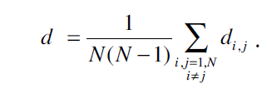
AVERAGE PATH LENGTH
The average path length, denoted by 〈d〉, is the average distance between
all pairs of nodes in the network. For a directed network of N nodes, 〈d〉 is

Slide 37
CONNECTEDNESS
A phone would be of limited use as a communication device if we could not call any valid phone number; email would be rather useless if we could send emails to only certain email addresses, and not to others.
From a network perspective this means that the network behind the phone or the Internet must be capable of establishing a path between any two nodes. This is in fact the key utility of most networks: they ensure connectedness.

Slide 38
CONNECTEDNESS (2)
In an undirected network nodes i and j are connected if there is a path
between them. They are disconnected if such a path does not exist, in which case we have d_{ij} = ∞
Example of the Textbook:
While there are paths between any two nodes on the same cluster (for example nodes 4 and 6), there are no paths between nodes that belong to different clusters (nodes 1 and 6).

Slide 39
CONNECTEDNESS
A network is connected if all pairs of nodes in the network are connected.
A network is disconnected if there is at least one pair with d_{ij} = ∞.
A component is a subset of nodes in a network, so that there is a path between any two nodes that belong to the component, but one cannot add any more nodes to it that would have the same property.

Slide 40

CLUSTERING COEFFICIENT
The clustering coefficient captures the degree to which the neighbors of a given node link to each other. For a node i with degree ki the local clustering coefficient is defined as
where L_{i} represents the number of links between the k_{i} neighbors of node i.
Note that C_{i} is between 0 and 1
• C_{i} = 0 if none of the neighbors of node i link to each other.
• C_{i} = 1 if the neighbors of node i form a complete graph, i.e. they all link to each other.
• C_{i} is the probability that two neighbors of a node link to each other.
Consequently C = 0.5 implies that there is a 50% chance that two neighbors of a node are linked.
In summary C_{i} measures the network’s local link density: The more densely interconnected the neighborhood of node i, the higher is its local clustering coefficient.

Slide 41
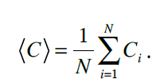
CLUSTERING COEFFICIENT
The degree of clustering of a whole network is captured by the average clustering coefficient, 〈C〉, representing the average of C_{i} over all nodes i = 1, ..., N,
In line with the probabilistic interpretation 〈C〉 is the probability that two neighbors of a randomly selected node link to each other.

Slide 42
Bibliography
1. ALBERT-LÁSZLÓ BARABÁSI: NETWORK SCIENCE
http://www.networksciencebook.com/
2. Filippo Menzer, Santo Furtando, and Clayton A. Davis: A First Course in Network Science

